Slide 1
LAKSHADWEEP ISLANDS
AUTHORS:- SRILALITHA M

Slide 2
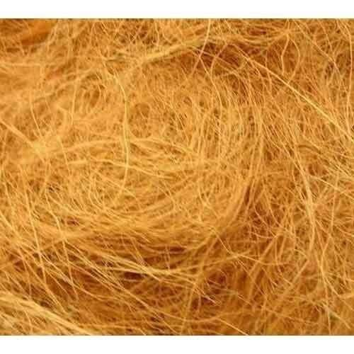
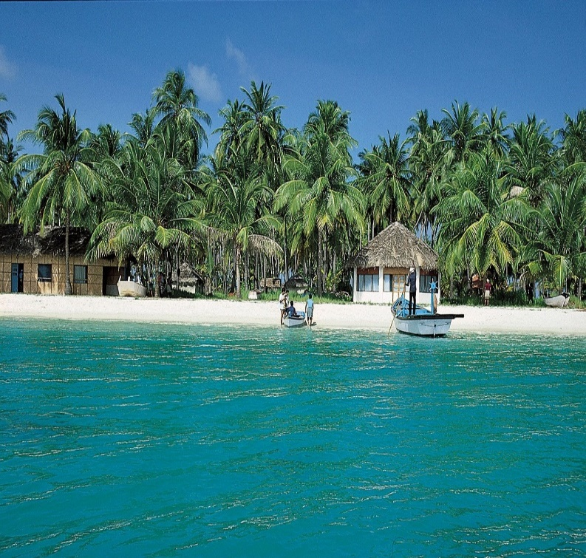
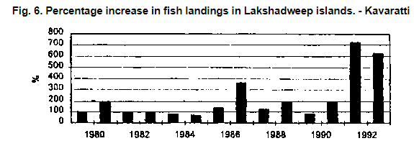
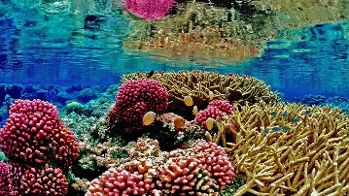
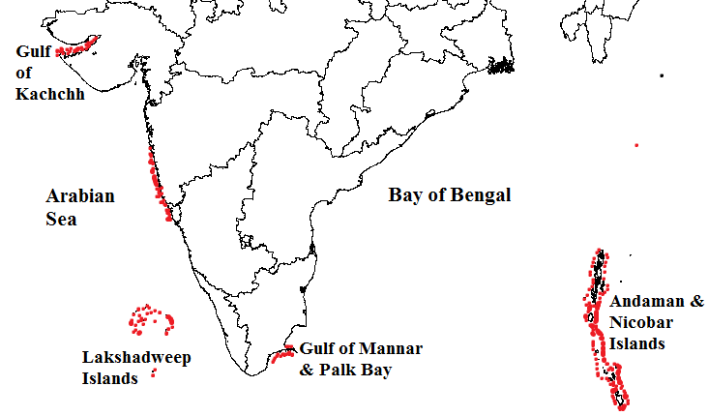
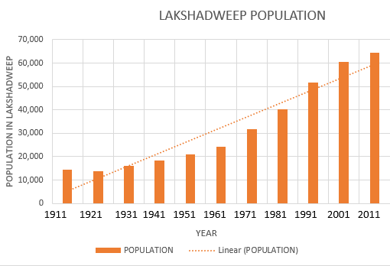
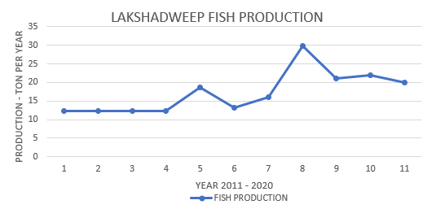
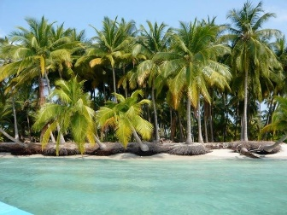
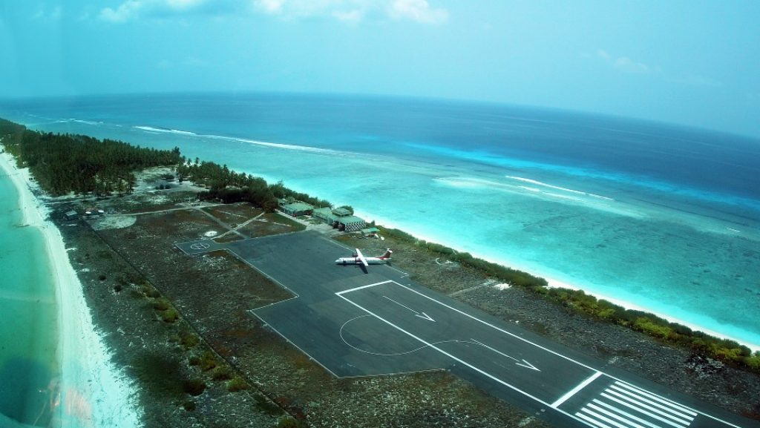
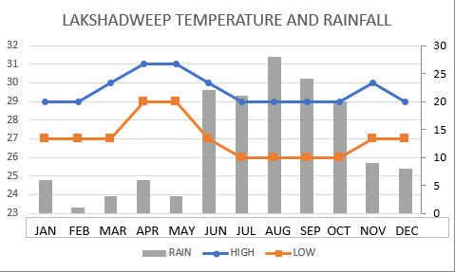
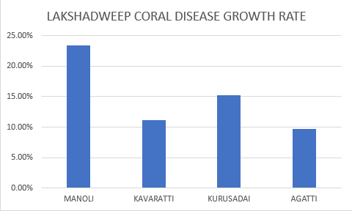
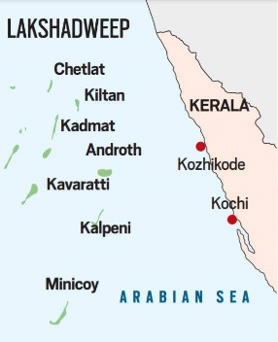
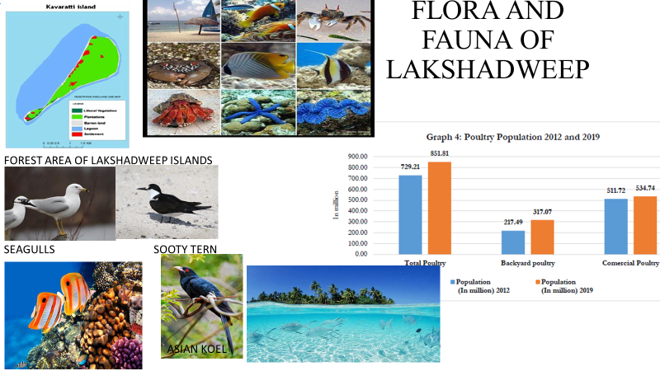
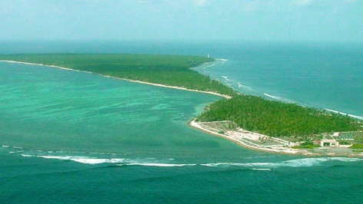
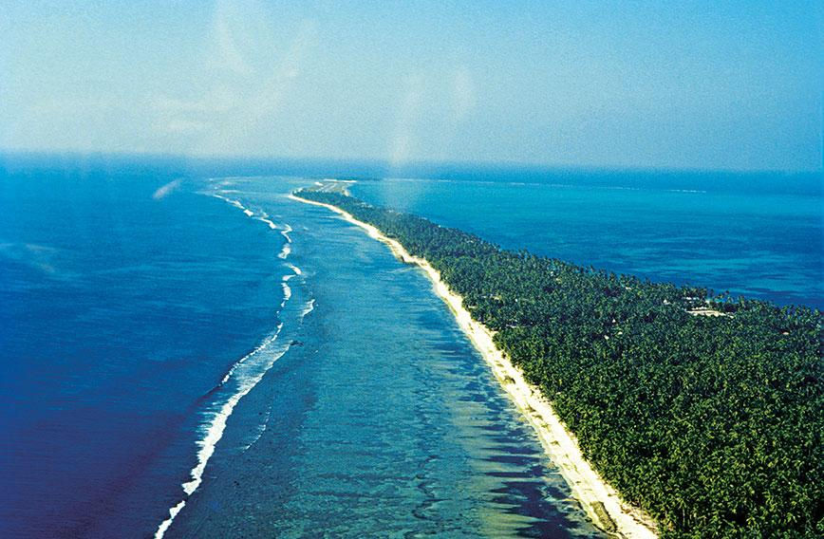
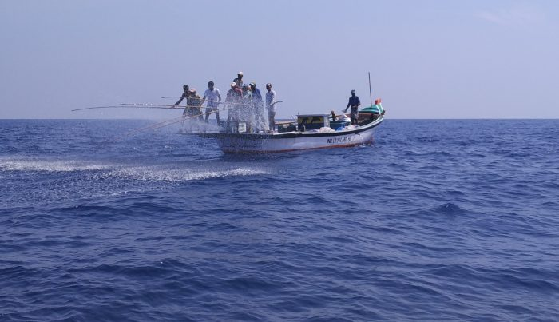
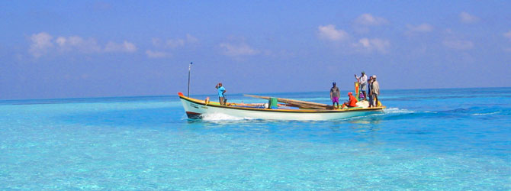
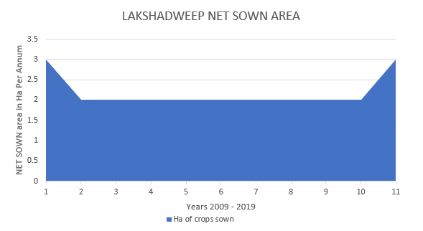
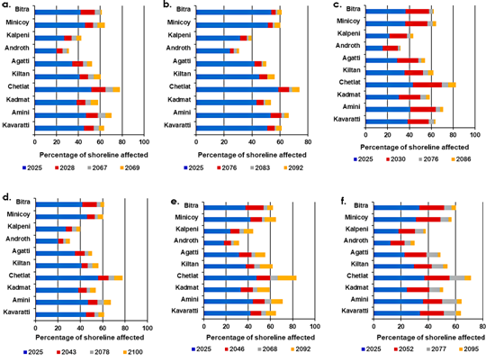
LAKSHADWEEP ISLANDS
AUTHORS :- SRILALITHA MUSTI
1. INTRODUCTION
‘Lakshadweep’ means a hundred thousand islands
It is constituted of 36 islands, out of which,
The administrative center is Kavaratti
b) MANUFACTURING
5. CORALS OF LAKSHADWEEP – GIFT FOR THE ISLAND
HABITATED | UNINHABITATED | NEWLY FORMED | SUBMERGED | CORALL ATOLLS
10 | 17 | 4 | 5 | 12
Fig: Coral Population in India – an abundant resource
Coral reefs play a very important role in in sustaining life. The following some of the importance of corals :-
Provide protection for the communities
They become habitat for fish
A lot of money is earned in tourism
provide jobs for the local communities
They can be new medicines
We can prevent threatening or depleting coral reefs by Daily activities, such as:-
Dispose trash properly
Minimize use of fertilizers
Be conscious while buying aquarium fish
Use environment friendly transportation
Reduce stormwater runoff
c) TRANSPORT AND TOURISM
India – Lakshadweep =) Cochin International airport - Agatti Aerodrome
Government supports tourism in this area, but negative environmental impacts make it necessary to have permit to enter the territory
2. RELIEF, SOIL AND CLIMATE
The climate varies from 17 degrees Celsius to 32 degrees Celsius, rainfall is 150 cm annually, and has a warm and humid climate
-The Agatti Aerodrome
Fig: the prevalence of disease rate in Lakshadweep Corals
KAVARATTI ISLAND – THE CAPITAL OF LAKSHADWEEP
6. THE LAKSHADWEEP DEPLETION:-
In a study, it was stated that within 2 generations, India has the probability to lose as much Lakshadweep as possible.
The Parali I. of Lakshadweep has disappeared due to Coastal erosion
4. ECONOMY
a) AGRICULTURE AND FISHING
Fig:- Area lost in each of the Lakshadweep Islands
https://www.researchgate.net/publication/235767087_Landscape_level_assessment_of_critically_endangered_vegetation_of_Lakshadweep_Islands_using_Geo-spatial_techniques, https://www.researchgate.net/figure/Map-showing-the-distribution-of-coral-reefs-in-India_fig1_309397974, https://www.fao.org/3/X5627E/x5627e0j.htm, https://vikaspedia.in/agriculture/agri-directory/reports-and-policy-briefs/20th-livestock-census, https://pib.gov.in/PressReleasePage.aspx?PRID=1728293, https://science.thewire.in/environment/lakshadweep-risks-losing-land-with-rising-sea-levels-study-says , https://icriforum.org/about-coral-reefs/what-are-corals/ , https://education.nationalgeographic.org/resource/coral

Slide 3
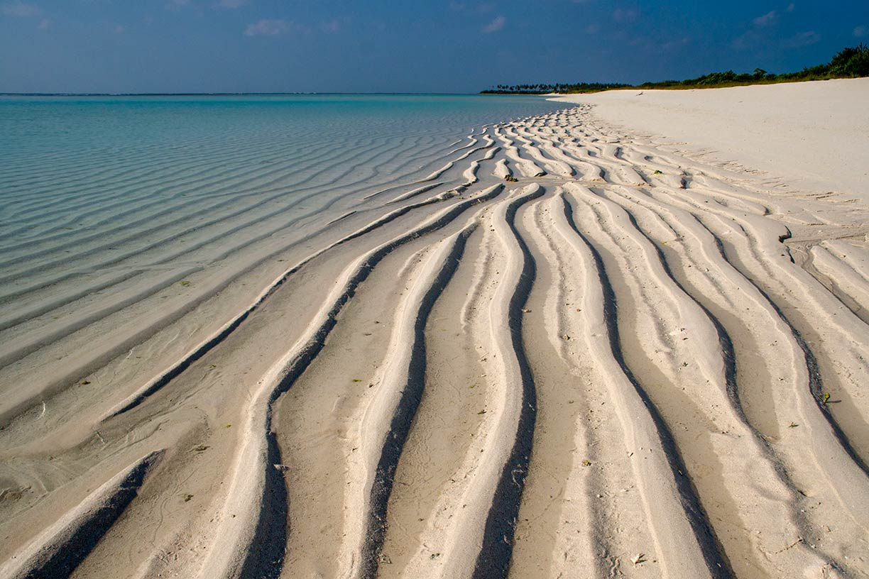
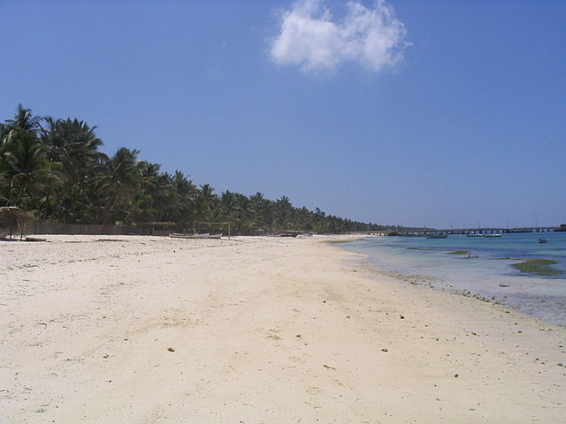
SOIL AND CLIMATE
HABITATED | INHABITATED | NEWLY FORMED | SUBMERGED | CORAL ATOLLS
10 | 17 | 4 | 5 | 12

Slide 4
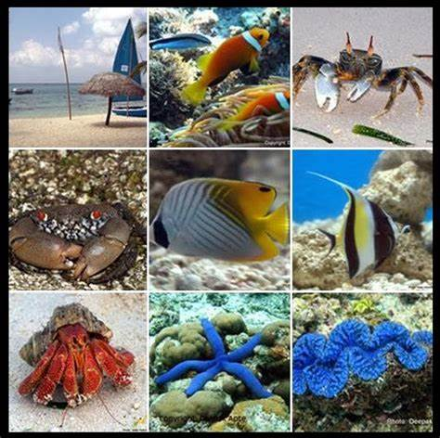
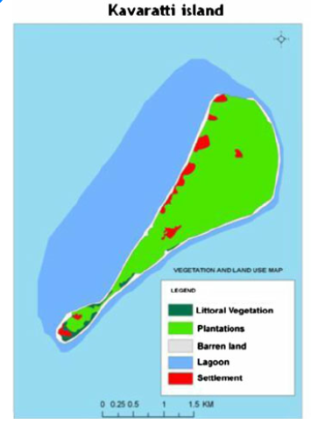
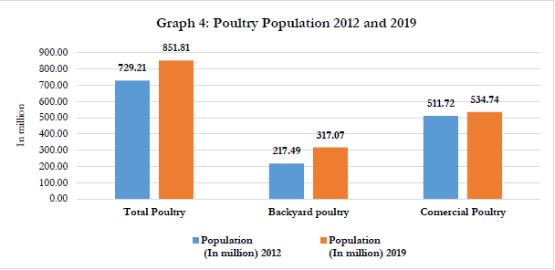
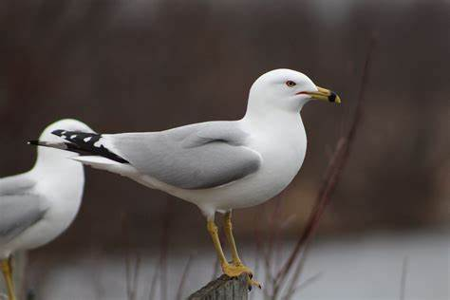
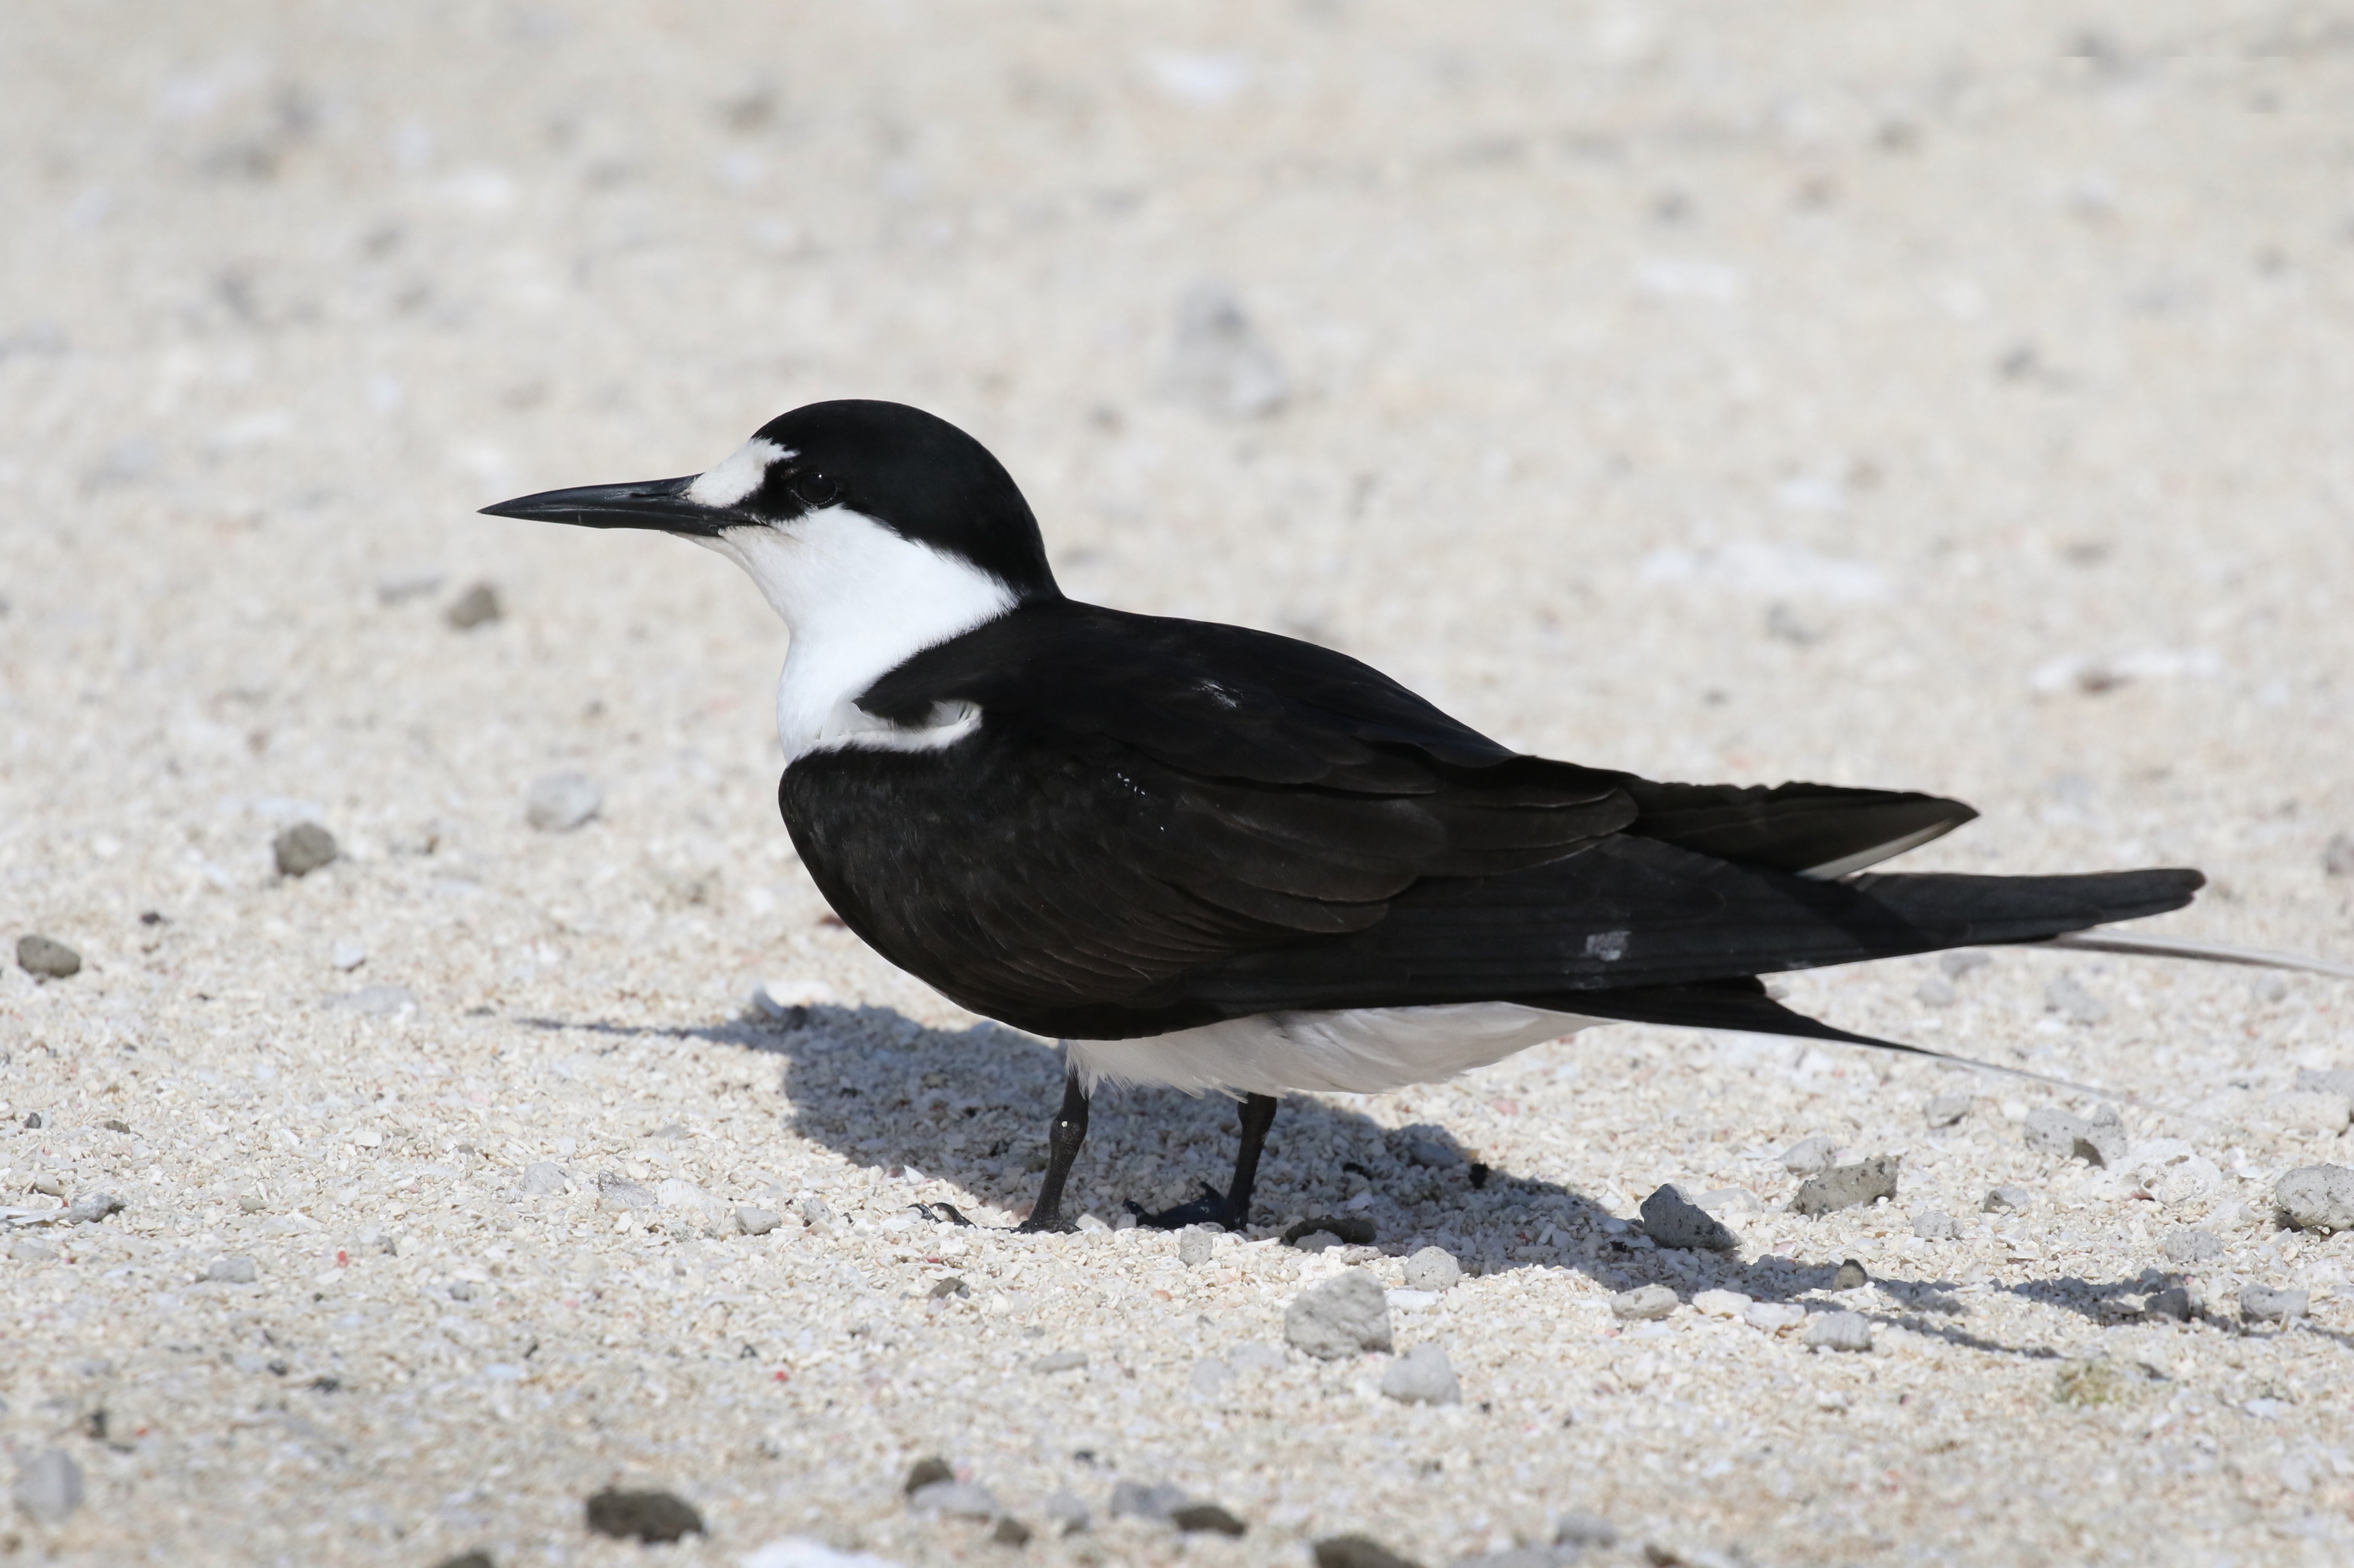
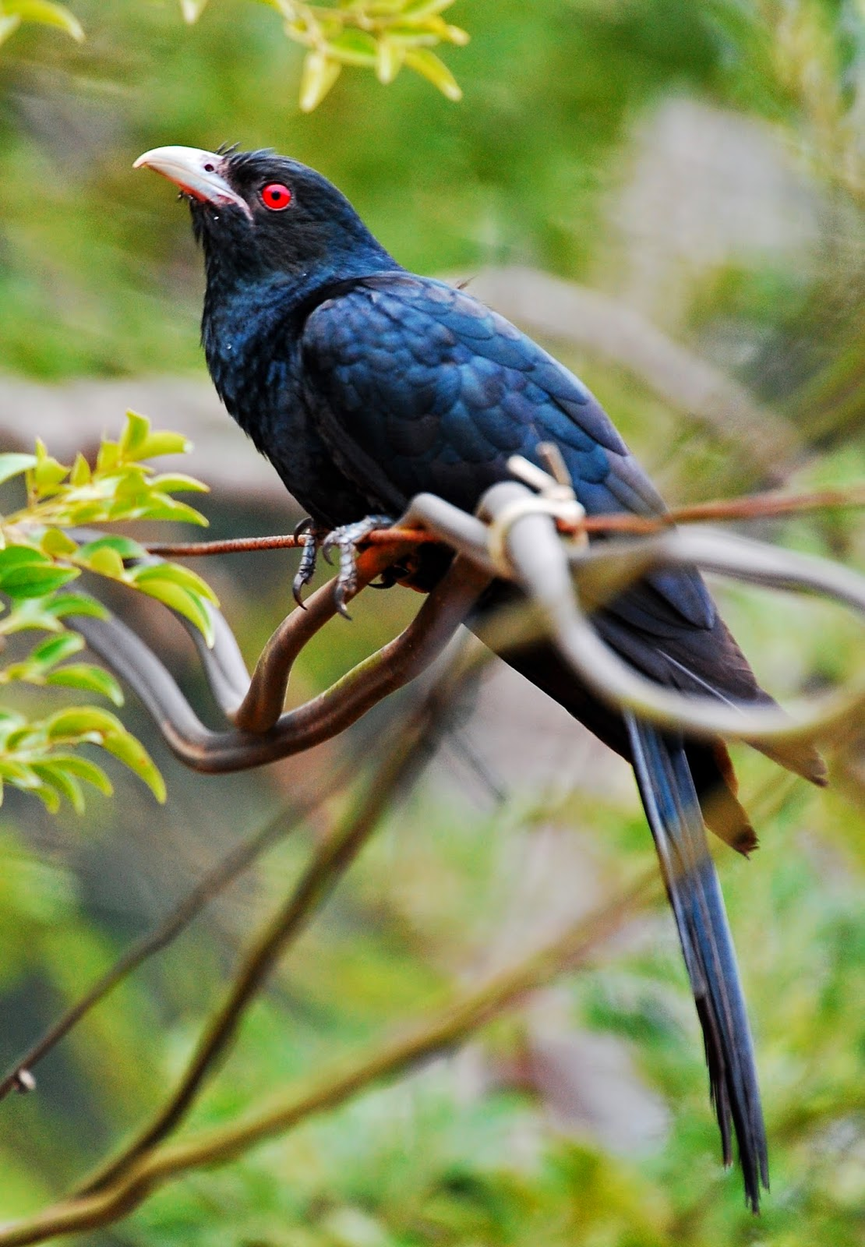
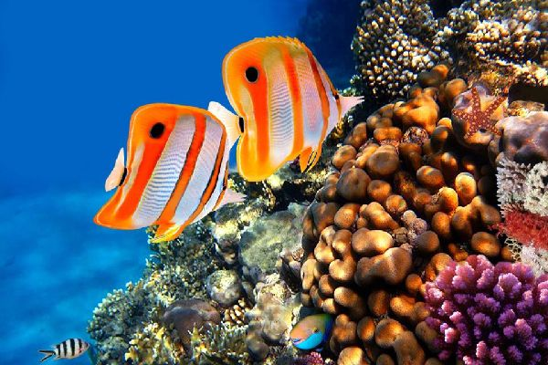
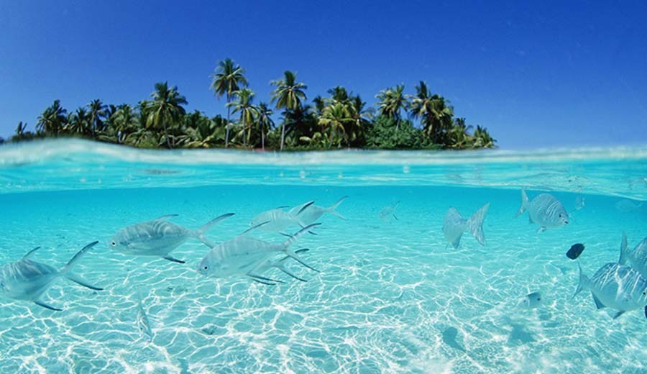
FLORA AND FAUNA OF LAKSHADWEEP
FOREST AREA OF LAKSHADWEEP ISLANDS
SEAGULLS SOOTY TERN
ASIAN KOEL

Slide 5
ECONOMY
AGRICULTURE AND FISHING
Copra of coconut is widely exported
Fishing is also very important
INDUSTRIES - Fish processing Industries are widely found

Slide 6
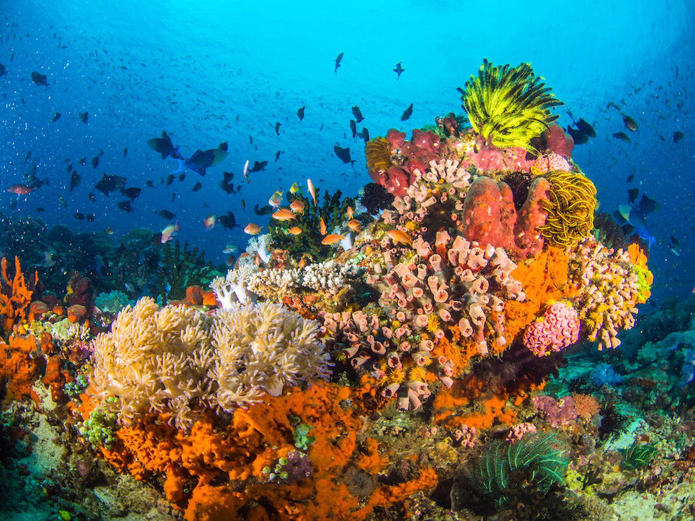
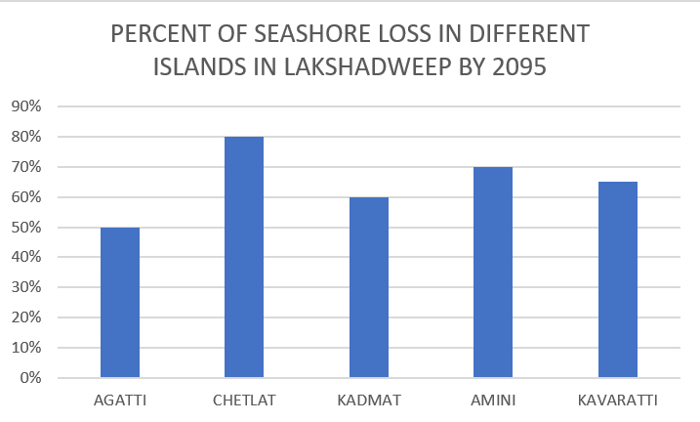
DEPLETION OF CORALS AND ISLANDS

